Slide 1
UNIVERSAL BANK
PERSONAL LOAN

Slide 2

BACKGROUND
Personal loan is a type of loan that allows flexible use, short- to moderate-term repayment options and relatively quick funding.They can help you meet your current financial needs. Generally it is money you borrow from a bank or other financial institution with fixed amounts, interest rates, a set repayment period and consistent monthly amounts over defined periods of time.
A bank's profit or a loss depends to a large extent on loans i.e. whether the customers are paying back the loan or defaulting. By predicting the loan defaulters, the bank can reduce its Non- Performing Assets.

Slide 3
ANALYSIS OBJECTIVE:
A relatively young bank is growing rapidly in terms of overall customer acquisition, and the bank wants to grow this base rapidly to bring in more loan business. So it want to explore ways of converting its liability customers to Personal Loan customers.For that the bank ran campaign last year it showed a healthy conversion rate of over 9% success. While designing a new campaign, we modeled the previous campaign's customer behavior to analyze what combination of parameters make a customer more likely to accept a personal loan?
This would be more helpful for bank to explore its wings towards loan business.

Slide 4
DATA SET FEATURES :
ID
Age
Experience
Income
ZIPCode
Family
CCAvg
Education
Mortgage
PersonalLoan
SecuritiesAccount
CDAccount
Online
CreditCard

Slide 5
QUESTIONS TO EXPLORE
UNIVARIATE ANALYSIS
1.What is the Personal Loan rate in the bank?
2.Credit card usage of those customers?
3.Rate of customers using online banking facilities?
4. Rate of universal bank customers having securities account?
5.Does the customer have a certificate of deposit (CD) account with the bank?
6. Does the bank customers are mostly educated?
7.What is the Family Size of Customers?
8. How much professional experienced people are the customers of bank?(EXPERIENCE)
9.Does the universal bank customers are middle aged?(AGE)
10.What is the Income of Customers in Bank?
11.Mortgage rate of Customers in bank?
12.What is avg usage of CreditCard in a month by customers?

Slide 6
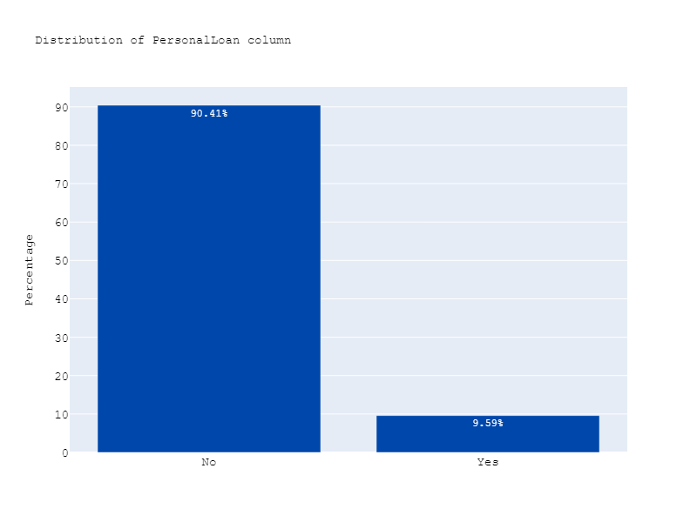
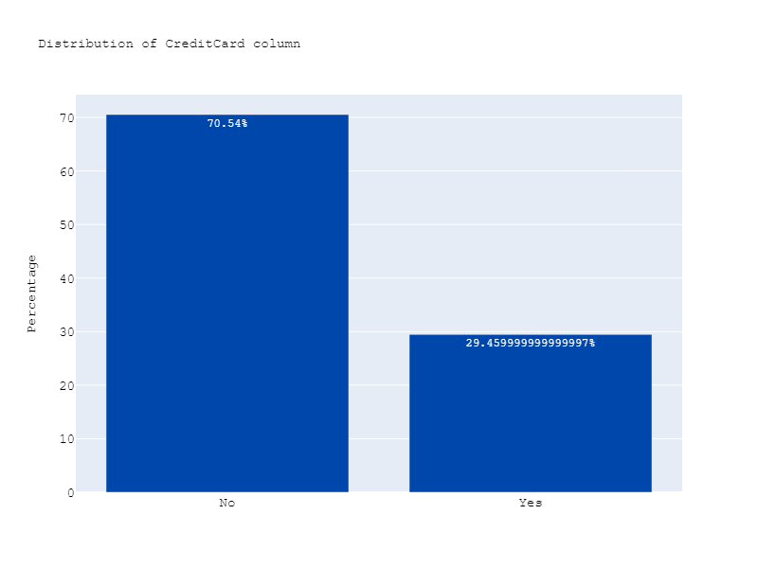








Plot shows the rate of Personal loan 9.59% customers took the loan and 90.54% doesn’t took the loan in previous campaign.
The plot depicts the Distribution of credit card among
customers i.e.29.45% customers are having the creditcard and 70.54% are not having CreditCards

Slide 7
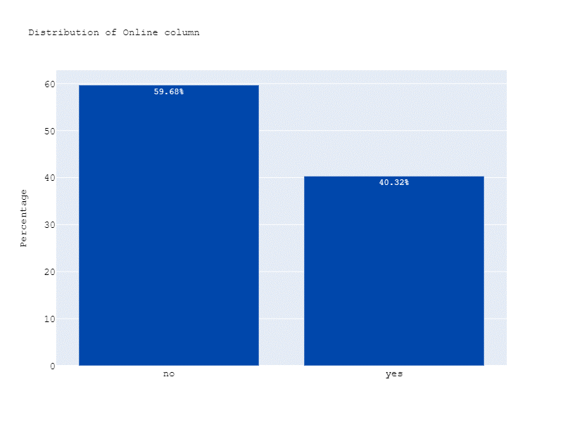
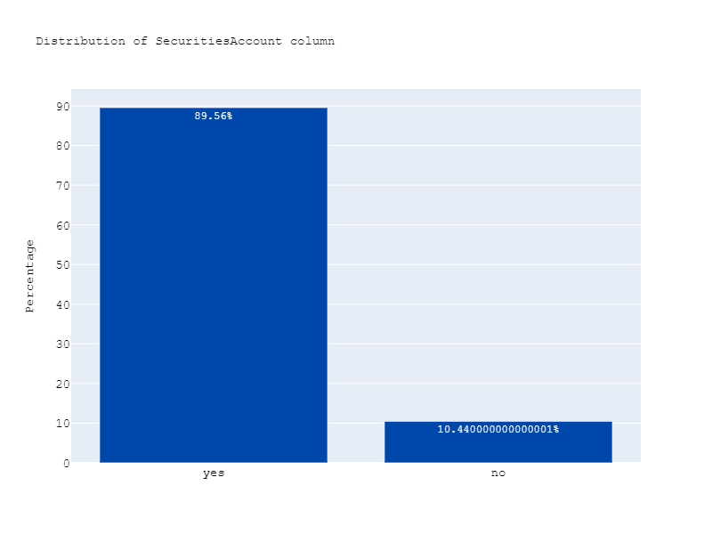
As shown in the plot 40.32% of bank customers are using online banking and 59.68% are not using online banking.
Plot shows the distribution of securities account here 10.42% customers are having securities account and 89.58% are not having securities account.

Slide 8
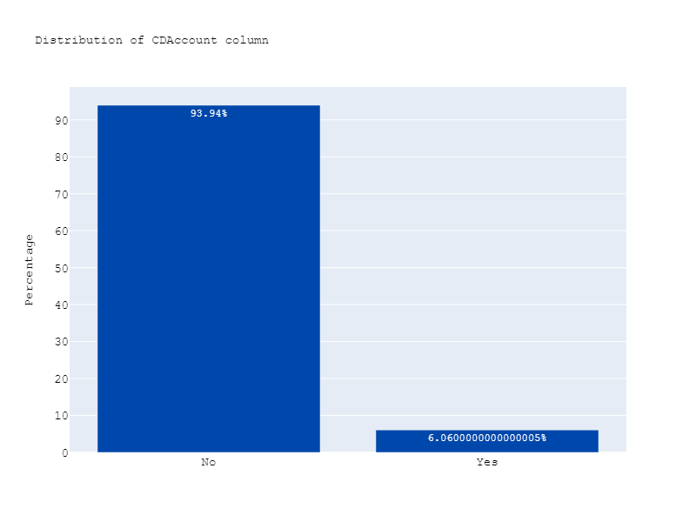
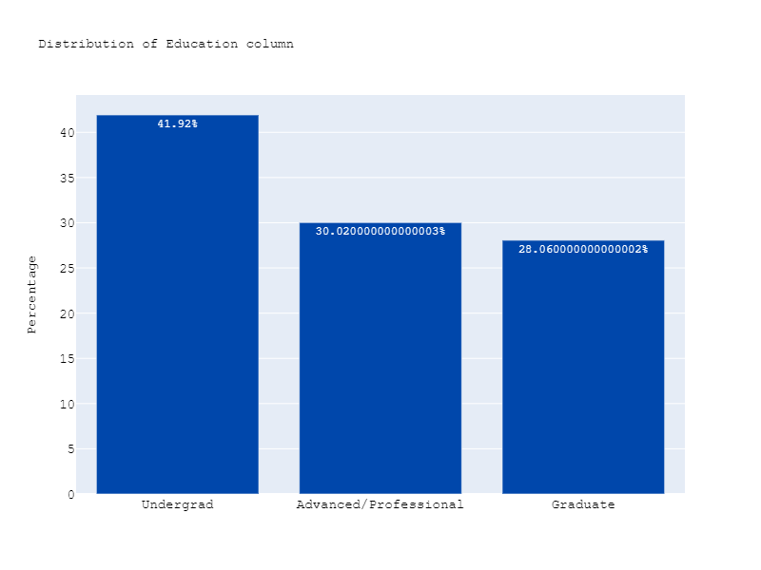
As shown in above plot 6.06% of bank customers are having CD Account and 93.94% customers are not having CD Account in universal bank.
Plot shows the distribution of education of bank customers here28.06% are graduates and 30.02% are advanced/professionals and remaining 41.92% are undergrad customers.

Slide 9
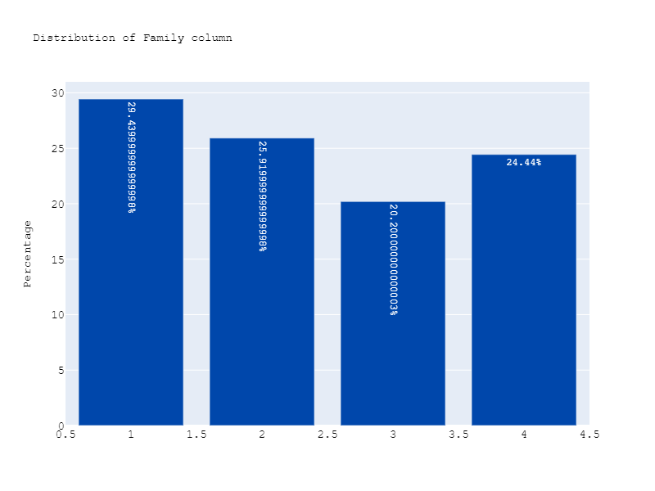
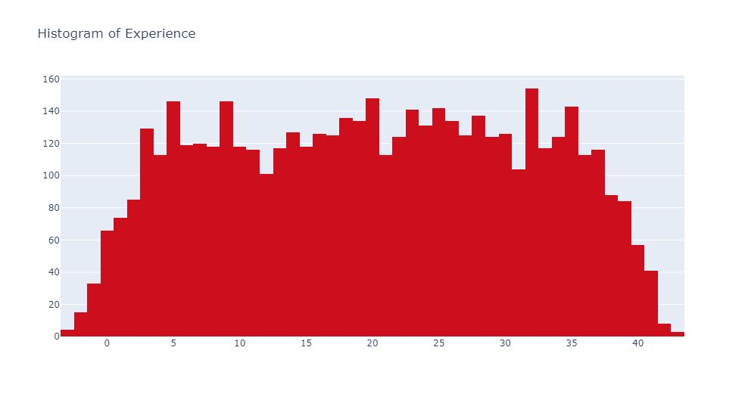
Plot shows the distribution of family size among bank customers here 24.44% are having 4 family members and 20.2% are having 3 and 25.9% are having 2 and remaining are single members.
Histogram shows the distribution of professional experience of bank customers in previous campaign.

Slide 10
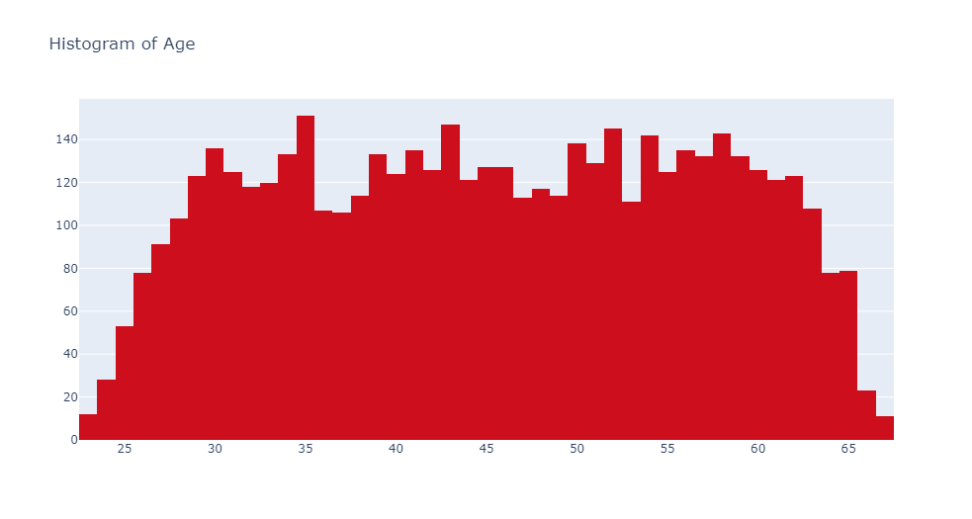
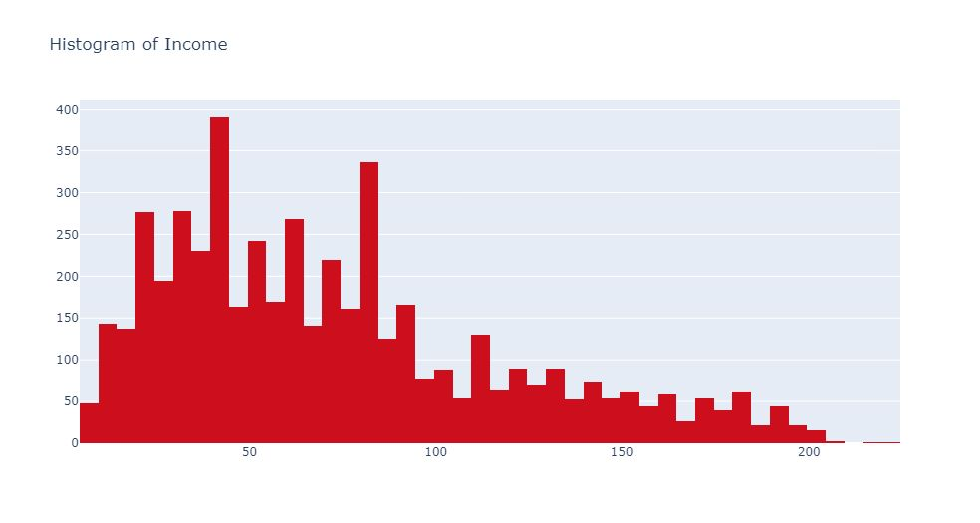
Above histogram depicts distribution of age of bank customers in previous campaign.
Here the histogram shows the distribution of income of the bank customers

Slide 11
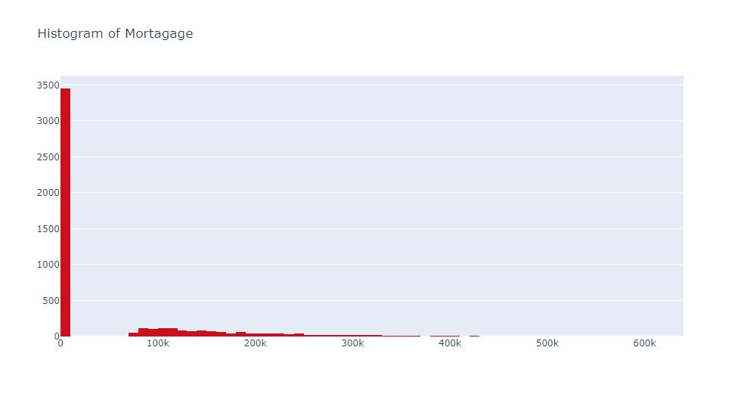
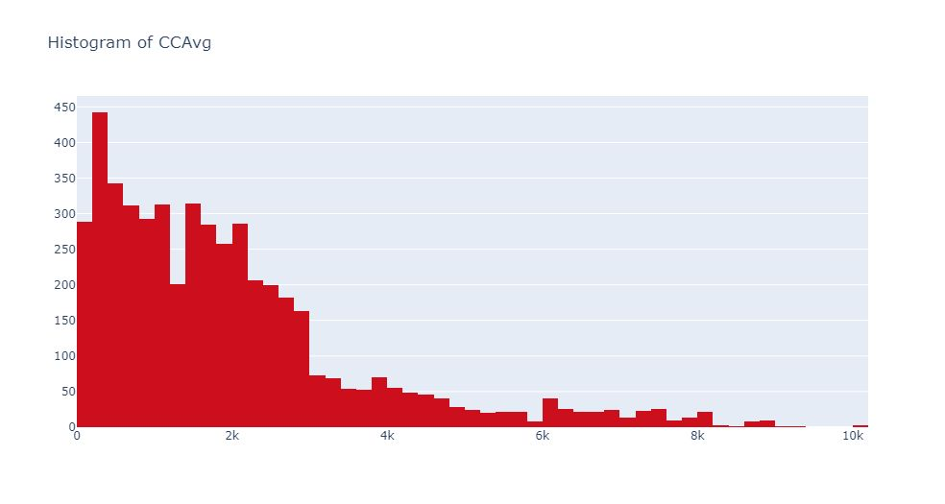
The histogram shows the distribution of the value of house mortgage of bank customers. Most Customers are not having Mortgage.
The histogram shows the distribution of average spending Using Credit cards in a month of bank customers.

Slide 12
QUESTIONS TO EXPLORE
BIVARIATE ANALYSIS
1.Does more educated people are likely to take personal loan?
2.If the customers with credit cards will take the loan actively?
3.Does the loan rate depends on customer family size?
4.Which age group people are most willing to take the loan?
5.Does customers having mortgage taking loan?
6.What is the loan rate relationship with the income of customers?
7.Did the more loan takers are having more CCavg?
8.How personal loan related to the professional experience of Customers?

Slide 13
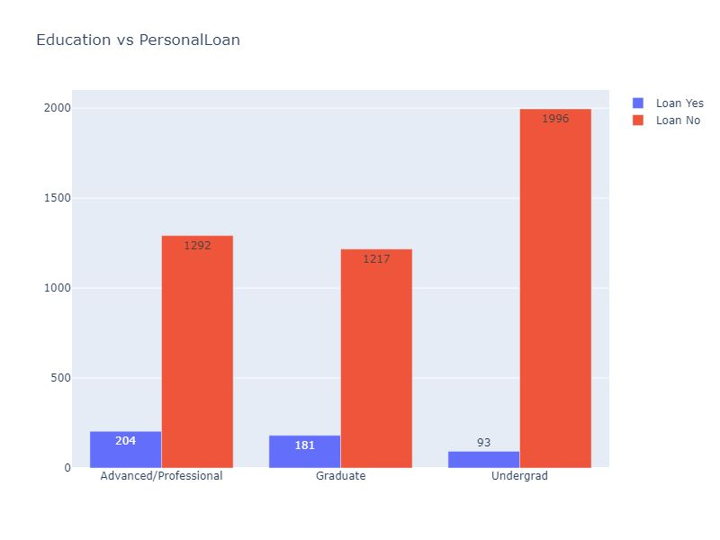
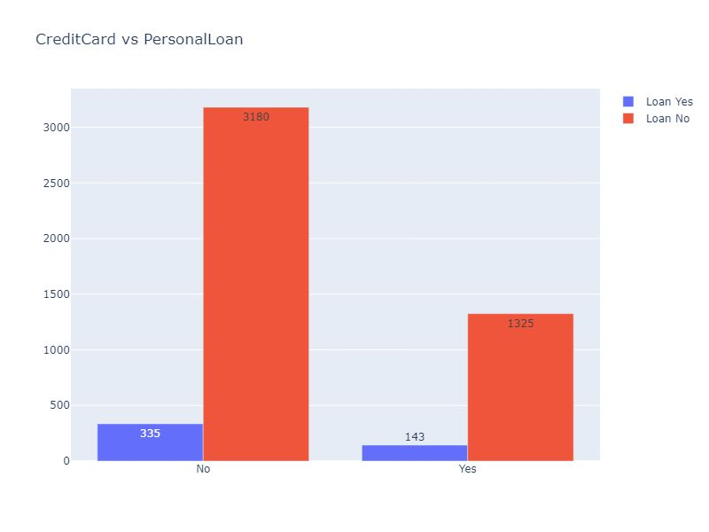
Plot shows relation between education and personal loan in that Advanced/professional customers are taking more loans.
Above plot shows CreditCard versus personal loan
in this customers without credit cards are more likely to take the loan .

Slide 14
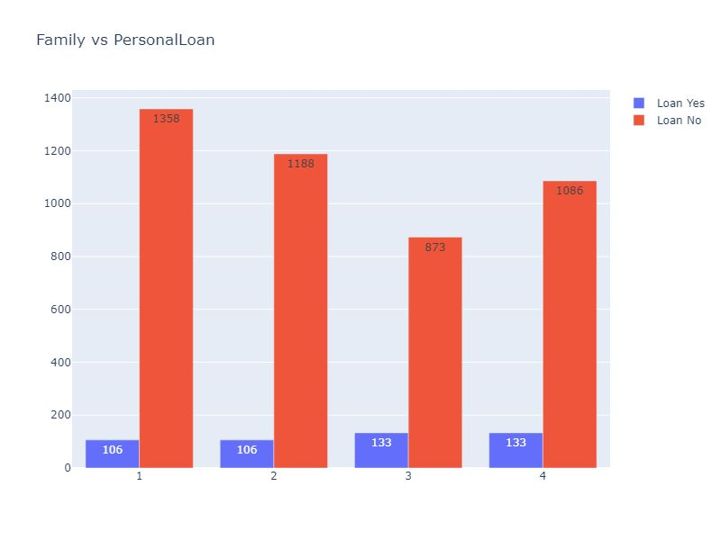
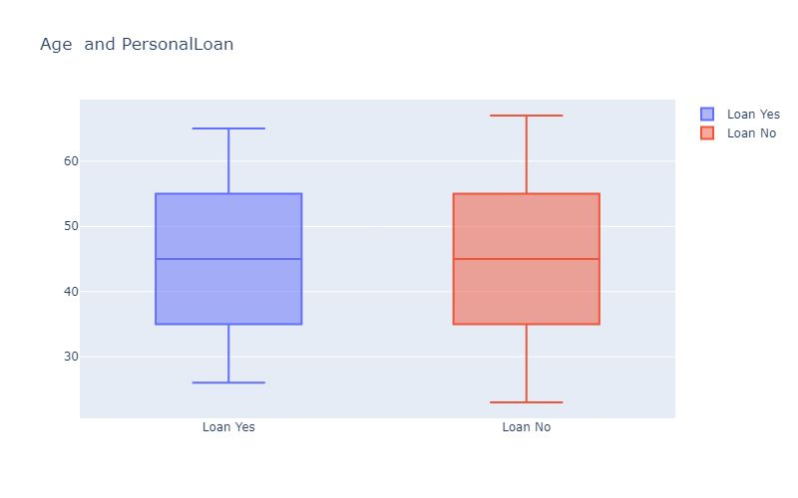
The plot shows relation between customer’s family size
And personal loan in this customers having 3 and 4 members in the family are actively taking a personal loan.
Box Plot Shows Relation B/w Age and PersonalLoan
Maximum Age of Customer likely to take Loan is 65 and
Minimum Age of Customers likely to take Loan is 26.

Slide 15
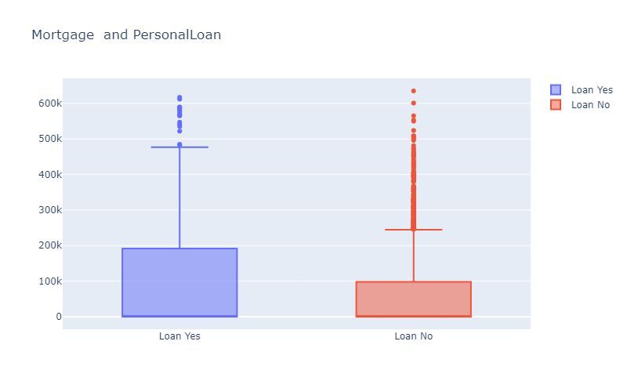
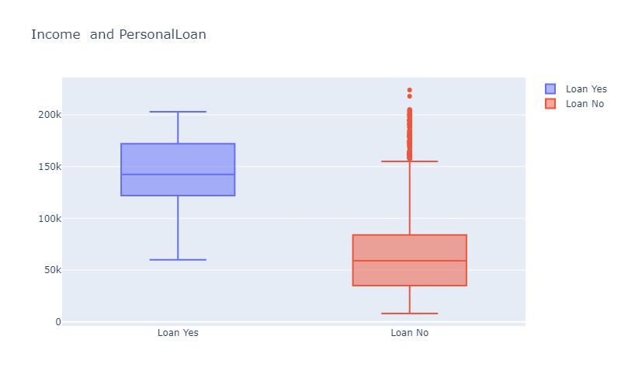
Customers With High Mortgage(>1L) are More likely to take Loan.
Plot Depicts that Customers Having More Income (above 1L) tend to take personal Loan more likely than low-Income Customers.

Slide 16
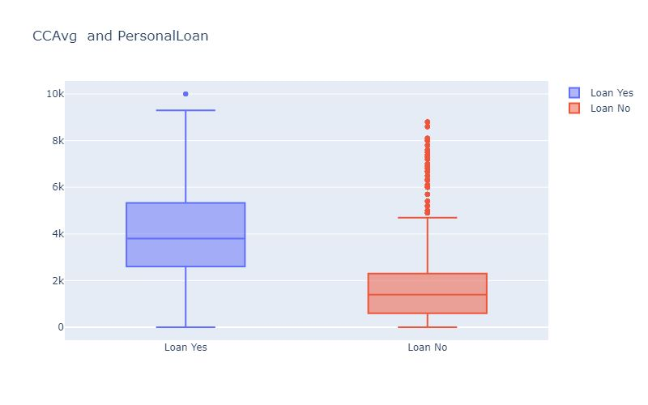
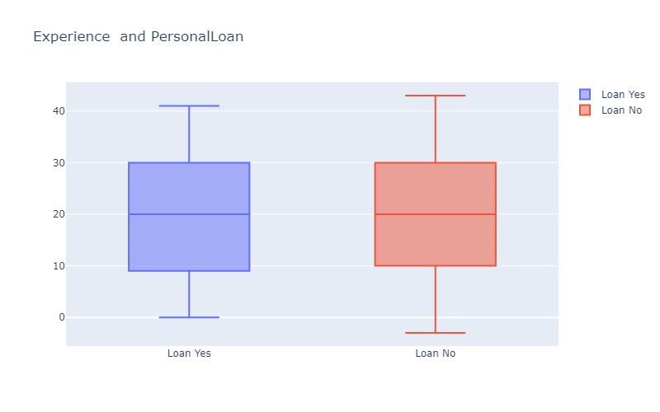
Customers Having more CreditCard usage per month are more likely to take loans.
Customer’s with 40 yrs of experience is max experience to take loan.

Slide 17
QUESTIONS TO EXPLORE
BIVARIATE ANALYSIS
1. Are the customers having large families maintaining securities accounts?
2. Does the more educated customers are using the online banking facility?
3. Which age group people are likely to have the CD Account?
4. Whether the more credit card usage is done by high-income customers?
5. Is the most securities accounts are from experienced customers?
6. Does the less educated customers are having more mortgage?

Slide 18
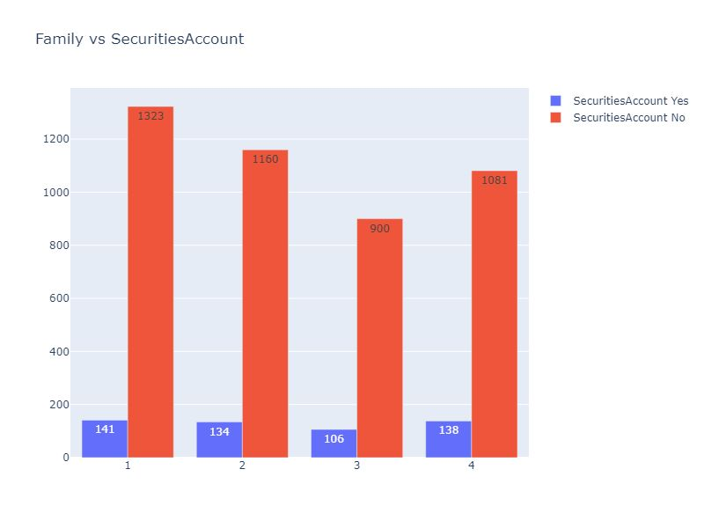
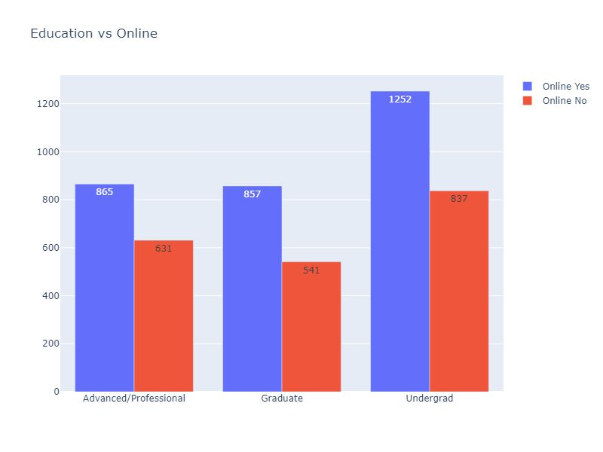
The plot shows the relation between family and securities account from these customers with family size as a single member and with 4 members having more securities Account in the bank.
Plot depicts the relation between customers education and online banking facilities from this more undergrad people are utilizing online banking facility in bank.

Slide 19
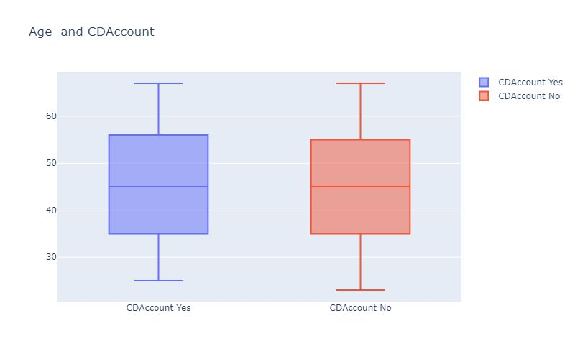
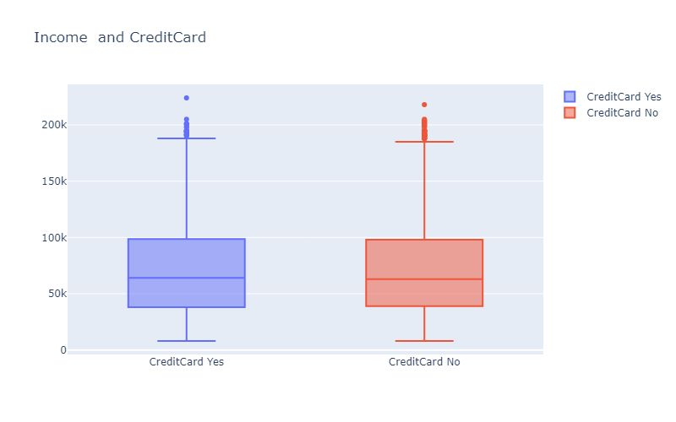
From this plot ,Customers with more age(>25) are more likely to have CDAccount.
Customers with more income are likely to Use Creditcard.

Slide 20
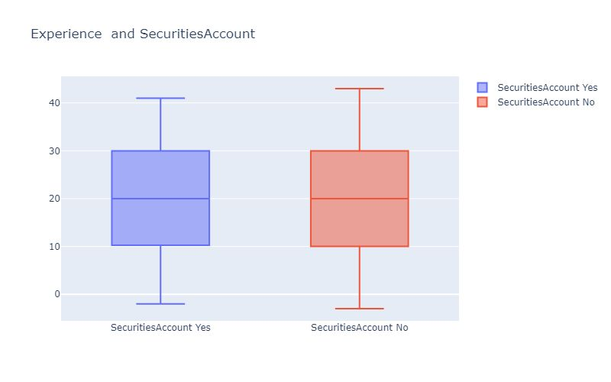
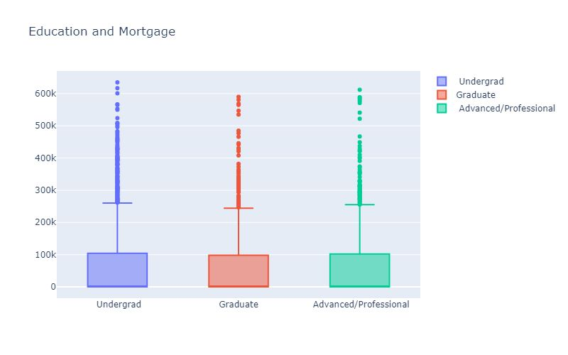
Customers of experience 41 is maximum experience of maintaining Securities Account.
Undergrad Customers are having more Mortgage

Slide 21
QUESTIONS TO EXPLORE
MULTIVARIATE ANALYSIS
1.Is there is any relationship between customers education,Income and Personal loan?
2.Whether the customers Family ,age effect the personal loan rate?
3.How does the customers Creditcard,CCavg are related to Personal loan?

Slide 22
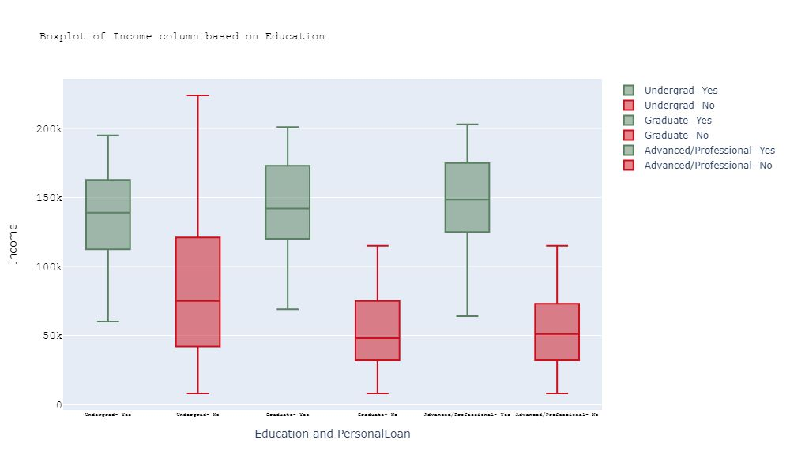
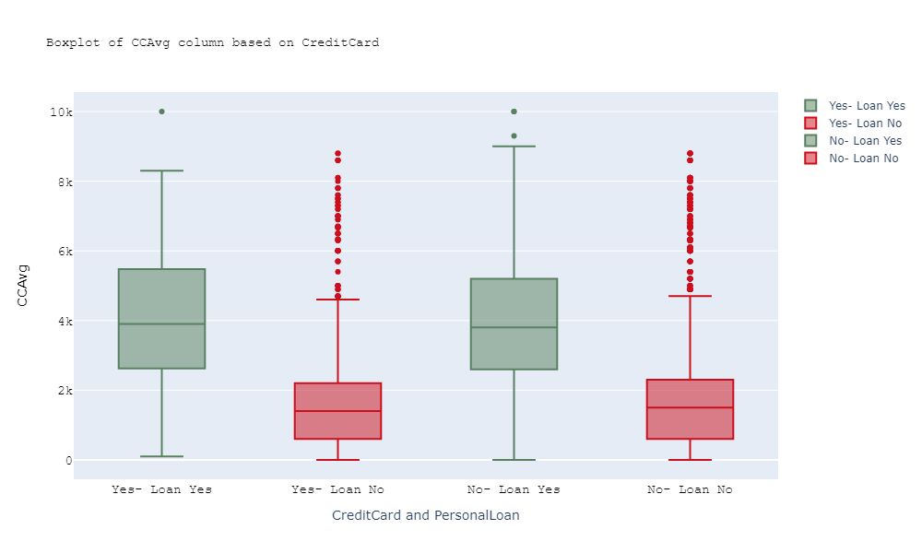
Customers With More Income(>50k), are More likely to take Loan.
Customers With More CCAvg are More likely to take Loan

Slide 23
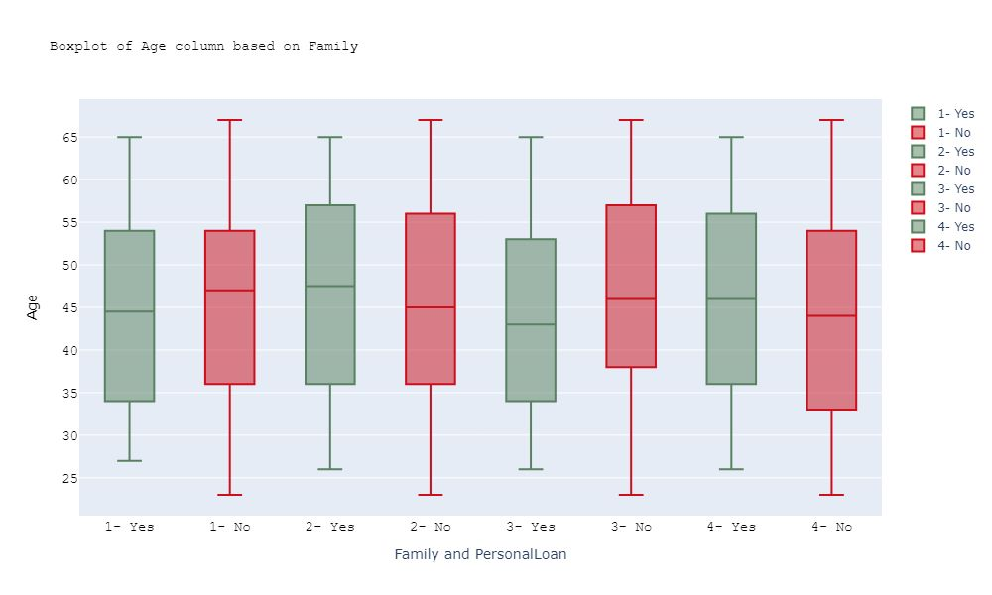
From this plot ,Customers with age in between 26-65 are more likely to take loan.

Slide 24
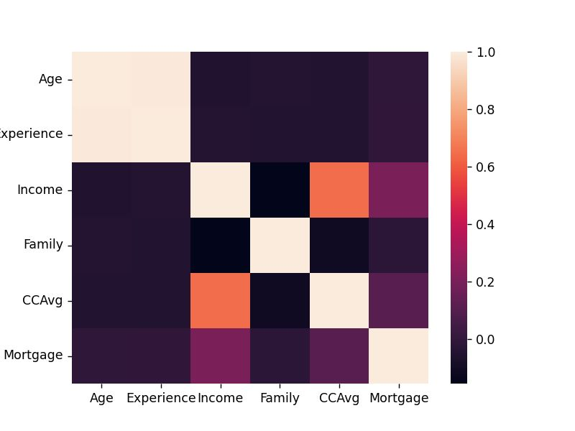
HEAT MAP
Correlation Among Some Features . Age and Experience are highly Correlated,
CCAvg and Income are also Correlated.

Slide 25
SUMMARY
From the analysis, we can conclude that features like Income and some others are merely important for deciding the acceptance of a Personal loan by the customer.
From the heat map age, experience are highly correlated CCavg , income are also correlated.
So Universal bank can focus more on Features like,
Customers with More Income are tend to take loan.
Customers with Age blw 26-65 are likely to take loan.
Customers with More CC avg are likely to take loan.
Customers Without Credit Card are tend to take loan mostly.
This may help in improving the bank’s loan businesses.
It was concluded that Personal loan was mostly preferred by customers having More Income ,ageb/w(26-65) ,More CC avg, not having CreditCard etc...
Since loans are the core business of banks and they can get profits directly by loan’s interest
there is a need of increasing number of loan’s business so they can use the above features and
Concentrate on them which we decided from given dataset.If any feature is newly introduced then the model should be tuned according to it.

Slide 26
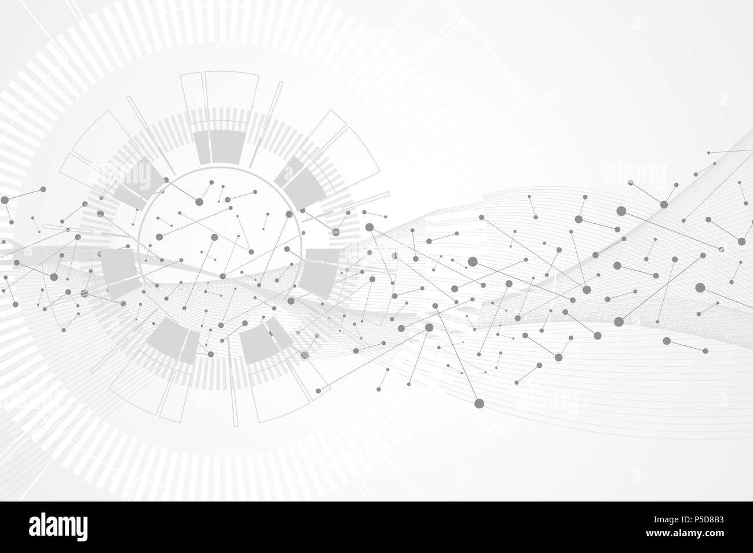
ANY QUERIES ?

